Slide 2
CNMI Assistive Technology Program (ATP)
Presented by:
CNMI Council on Developmental Disabilities
&
Assistive Technology Program

Slide 3
Let’s start of by defining…..
Assistive Technology:
“Any item, piece of equipment, or product system, whether acquired commercially of the shelf, modified or customized, that is used to increase, maintain, or improve functionally capabilities of individuals with disabilities.
Assistive Technology Services:
An assistive technology service is “any service that directly assists a person with a disability in the selection, acquisition, or use of an assistive technology device.”

Slide 4
The ATP Mission:
To provide and demonstrate how Assistive Technology can transform limitations into opportunities. We work toward this mission by providing access to Assistive Technology and related services that enable individuals with disabilities to achieve productivity, independence, and success according to their needs and interests.
Our ATP Center:
Provides support and services to people of all ages and abilities throughout the CNMI. We work closely with Family Members, Teachers, Medical & Therapeutic Professionals, Schools, Businesses, Government Agencies and Vendors to better help them serve the needs of individuals with disabilities.

Slide 5
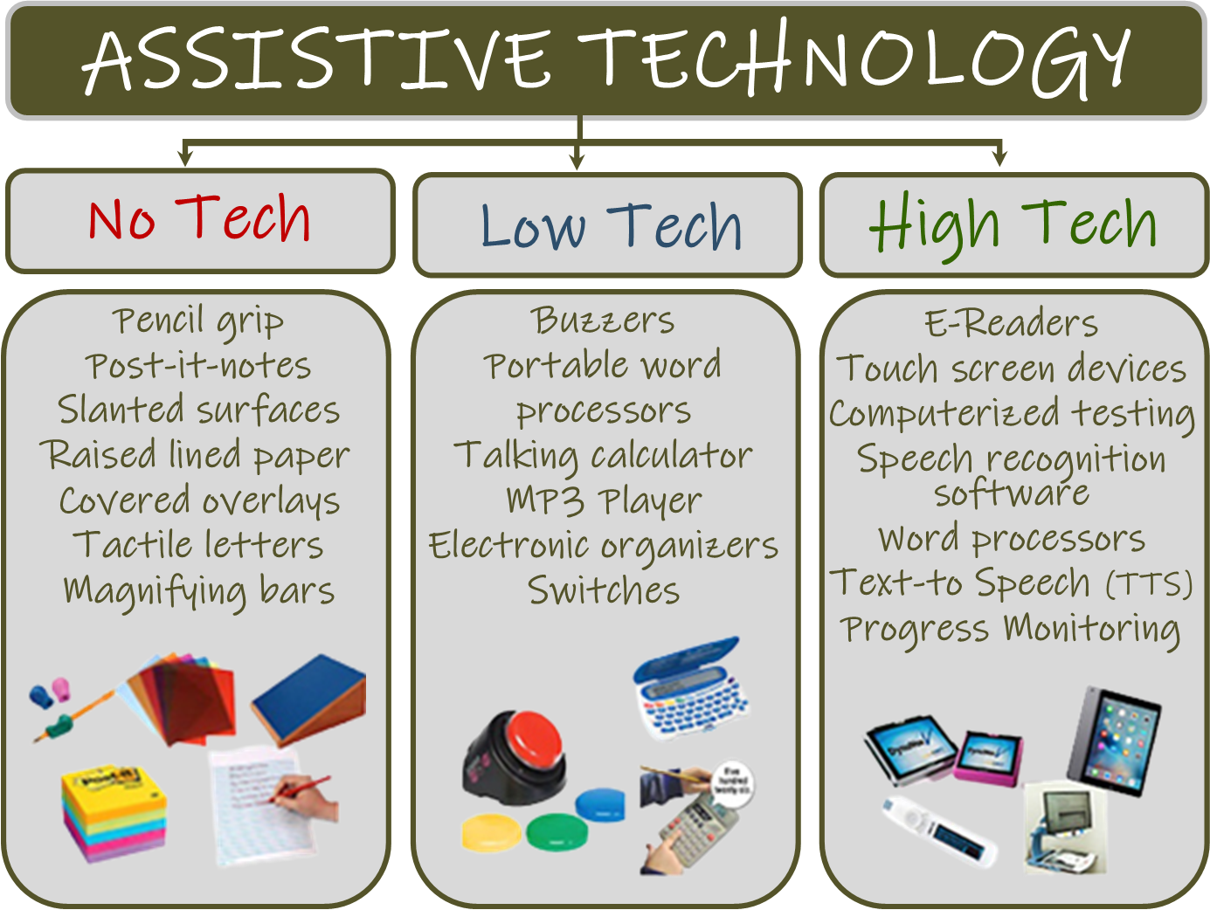
Assistive Technology
essentially falls into three categories:

Slide 6
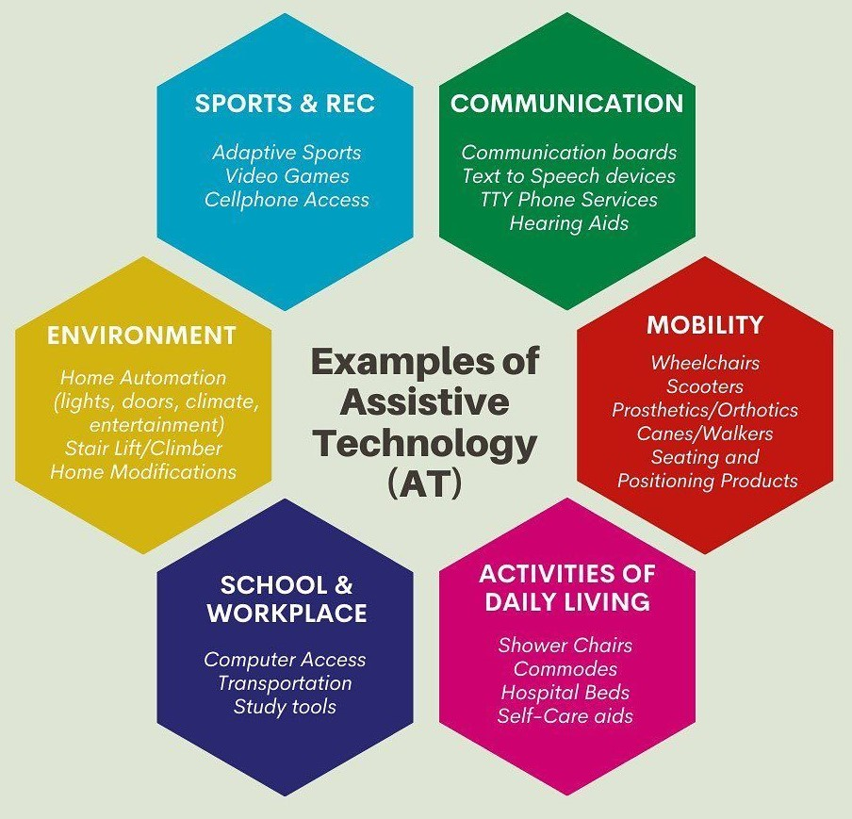
Areas that AT looks at…..

Slide 7
Lets summarize what ATP can do for you…
Resource and Referral:
Not sure where to start? Let us put our research and expertise to work to help guide you to the resources you need. Information and catalogues are available on a wide variety of Assistive Technology products and services.
Device Reutilization Program:
The goal of the CNMI Assistive Technology Exchange is to help get Assistive Technology Devices that are no longer being used into the hands of people who need and can benefit from them. The program brings together CNMI consumers and families who are buyers and or sellers of AT together with the goal of increasing acquisition of AT.

Slide 8
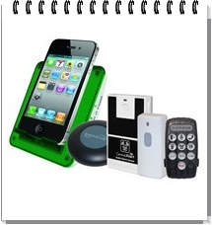
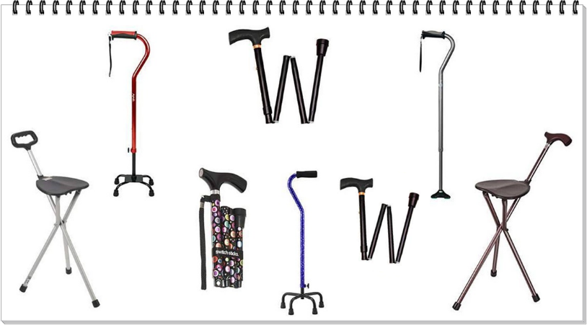
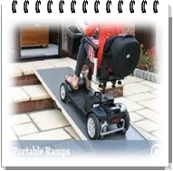
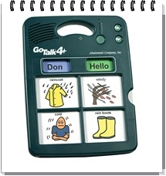
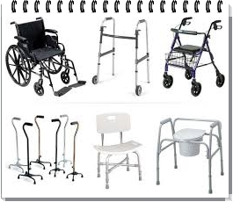
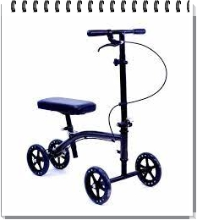
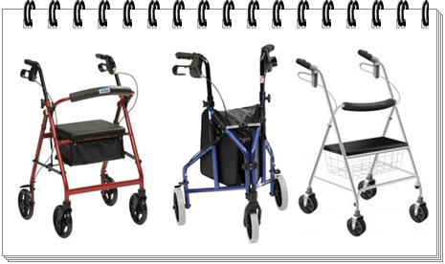
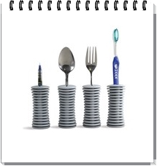
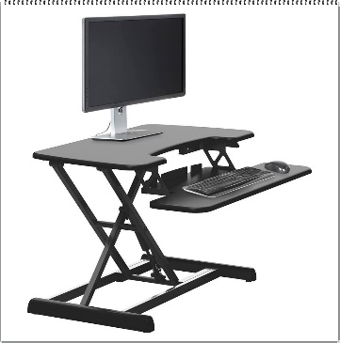
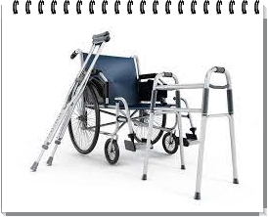
Device Loan & Demonstration Program:
Before you purchase Assistive Technology of any kind, try it out first. We can lend you what you are looking for to ensure that it is the right solution for your specific needs. Our Lending Library Inventory includes:
Hardware/Software for Computer Access
Educational Aids
Vision Aids
Communication Devices
Environmental Control Devices
Hearing Equipment
Mobility Equipment
Daily Living Aids

Slide 9
Please refer to our brochures for our contact and additional information. You can access our PowerPoint presentation on our website under the Events tab.
CNMI Council on Developmental Disabilities
And
Assistive Technology Program

