Slide 1


Slide 2


Slide 3
OPPORTUNITYISNOWHERE

Slide 4
OPPORTUNITYISNOWHERE

Slide 5
OPPORTUNITYISNOWHERE

Slide 6

THE BEST TIME TO PLANT A TREE
WAS 20 YEARS AGO

Slide 7
THE SECOND-BEST TIME IS
NOW
Chinese Proverb

Slide 8

YOU MISS
100%
OF THE SHOTS
YOU
DO NOT TAKE
Wayne Gretzky

Slide 9
If you keep doing what you have always done you will get what you have always got
Stephen Covey

Slide 10
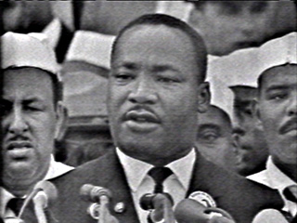
Life’s most persistent and urgent question is, what are you doing for others?
Dr Martin Luther King, Jr

Slide 11
LET’S PLANT A SEED
TODAY

Slide 12
LET’S
TAKE
THE SHOT
NOW!

Slide 13
CHALLENGING
BETTER
LET’S DO
SOMETHING
DIFFERENT
TODAY
INCONVENIENT
SELFLESS

Slide 16
WHAT
EMPLOYERS
ARE LOOKING FOR
ISLAND TRAINING SOLUTIONS
OVR

Slide 17


Slide 18
OPPORTUNITYISNOWHERE

Slide 19
OPPORTUNITYISNOWHERE

Slide 20
OPPORTUNITYISNOWHERE

Slide 21

The best time to plant an oak tree was 20 years ago; the second best time is now
Chinese Proverb

Slide 22
YOU MISS
100%
OF THE SHOTS
YOU
DO NOT TAKE
Wayne Gretzky

Slide 23
If you keep doing what you have always done you will get what you have always got
Stephen Covey

Slide 24
Life’s most persistent and urgent question is, what are you doing for others?
Dr Martin Luther King, Jr

Slide 25
LET’S PLANT A SEED
TODAY

Slide 26
CHALLENGING
BETTER
LET’S DO
SOMETHING
DIFFERENT
TODAY
INCONVENIENT
SELFLESS

Slide 27


Milestones in 2006
Every time I looked up and thought ‘I cannot do this’, I turned and looked at how far we had travelled
Sherpa Tenzing Norgay GM

Slide 28
If you keep doing what you have always done you will get what you have always got
Stephen Covey

Slide 29
Life’s most persistent and urgent question is, what are you doing for others?
Dr Martin Luther King, Jr

Slide 30

Let’s See Where We Are
Who has worked before?
Who has applied but not gotten an interview?
Applied, Interviewed but no Job
Who has not applied for a job?

Slide 31
Your Past Does Not Define Your Future
No Work History
Poor Work History
Transportation
Family

Slide 32


Slide 33
YOUR DISABILITY DOES NOT DEFINE YOU EITHER

Slide 34
SKILLS VS SKILLS
Technical Skills
Work Experience Skills
Soft Skills
Transferrable Skills

Slide 35
Where to Finds Jobs
On-line (Company Websites and Social Media and Marianas Labor)
Networking (Friends and Family)
Newspaper (very few opportunities

Slide 36
Quality Over Quantity
Apply at companies that you want to work for
Apply as companies who hire people with disabilities
Apply at companies recommended by OVR

Slide 37
YOU NEED THESE TO GET A JOB
FRIENDLY
POSTIVE ATTITUDE

Slide 38
THE POWER OF FRIENDLY!
Top quality for getting hired.
Shows you care about the person first …process second.
Friendly makes sales in business…
“they are so nice”

Slide 39


Slide 40

SMILE

Slide 41


Slide 42
Positive Attitude
Sets the tone for your day
Allows you to focus on you and your perfomance
It is not what happens to you it is how you deal with what happens to you.
Employers are looking to for people with positive attitudes and smiles

Slide 43
Positive Attitude is needed for getting a job
It is hard
It takes time
It takes perseverance
It is frustrating
You Now Have A Job and That Is To Get A Job

Slide 44

Attitude - Personal Accountability and CSE
THIS IS YOUR SHOW!
The blame game ☺ Finger pointing
101.
  Standards, rules, regulations
Under promise and over deliver
The Mirror Never Lies…
  when in doubt, you could have probably
  made a difference.
Challenges /Stress : practice the GOLDEN RULE. Empathy is a great guide to those needing someone to show them the way. They also want the easy path to their needs...not an obstacle.

Slide 45
A YES ATTITUDE (Jeffery Gitomer)
Belief in yourself
  Believe and you will achieve
  Failure is just another opportunity to learn
Investment in yourself
  Reading, association with positive things

Slide 46
Attitude Actions Right Now!
Be nice Praise others
Be kind Take responsibility
Smile Be proud of your work
Make friends Be proud of your accomplishments
Say nice things Don’t worry….be happy
Need to work at this EVERYDAY

Slide 47


Slide 48
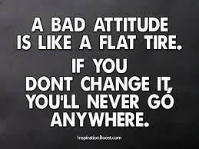

Slide 50
READY TO WORK
GAME PLAN
For winning your first job!
Notes:
Getting hired is like trying to win a game in a sport. You have to be prepared, practice your skils, know the rules, be fit enough to participate and know your limits. In short you have to be prepared!

Slide 51
Just like you, the employer is looking for a great candidate to fill a position
You should be looking for a good employer that can help you grow.

Slide 52

BE READY TO MEET YOU NEXT EMPLOYER

Slide 53
YOU Must Know YOU
No one knows you better than you.
What are your likes…dislikes?
Notes:
Like in a sport, you need to know what position you are good at and what needs work. Most importantly you need to know you.
Companies NEED great people. Your job is to get across the company you are what they need!
If you do not spend time preparing you resume and your interviewing skills, an employer will notice. If you won’t prepare for a simple job interview, how will you be able to perform for that company?

Slide 54
What Jobs are available in the CNMI?
Let us break up into groups and list out the jobs you think are out there.

Slide 55
Are you willing to start at the bottom?

Slide 56
President – Delta Management Corp
President – Prime Group. LTD
Owner – Island Training Solutions
Director – The Bridge Project
Prep cook
Dish washer
Janitor
Lawn Mower
Shrimp peeler – Potato peeler
Pizza Maker
Waiter
Are you willing to work to get what you want?

Slide 57

You want to get a job?...
You better get training; the competition is tough!
Get in Shape! JOB SEARCH SHAPE!
Research…get to know the
  career, field or business you want to work for.
Do not go into an interview
without knowing a little
about the company you are applying with.
Prepare-Practice (get a coach or personal trainer)
Notes:
Training to win in a sport at any level you have to train….studying to pass a test is training too. The more you “train” or study be better you will do on the test….the same goes for job hunting.
Know a bit the company you are applying with…image, charity, expansion.
Make sure you review your written materials for grammer, spelling etc…this is a way to weed out applicants.
Practice interviewing with friends and family. Nothing can substitute for this.

Slide 58
How do you make the team (Get Hired)
Past playing history
  Discussion with former team coaches/players. Scouting
Desirable Skill Set (are you a good match)
Trainable (attitude)
Shows desire to improve (attitude)
Willingness to practice hard (attitude)
Able to work on THIS team (attitude)

Slide 59
JOB SEARCH 101
FACE TIME FACE TIME FACE TIME
Dress and act right to pickup the application and when you Drop off the application
Never send someone else
Follow up in person

Slide 60
Know The Company You are Applying For
Talk to current / former employees
Read the newspaper… Check the web or website…corporate giving, growth, employee awards.
Learning the location (s)
Learn about the products-services
Visit the location and business if applicable.
Charitable giving – Community involvement

Slide 61
Skills Employers are Looking For
Communication
  Good speaking and writing
Flexible – adaptable
  Hours-days
Honesty – Integrity
Teamwork
Interpersonal
Motivated
Analytical
Computer Knowledge
Organized
Work ethic

Slide 62

GAME DAY! The Interview
BE ON TIME
Know the location, building etc
DRESS FOR SUCCESS
ATTITUDE!
Notes:
If there is a job you really want you might want to apply for few positions to get real world practice time before interviewing with the company you really what to work for.

Slide 63


Slide 64
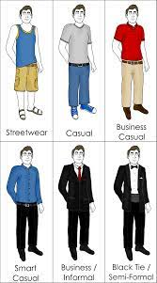

Slide 65
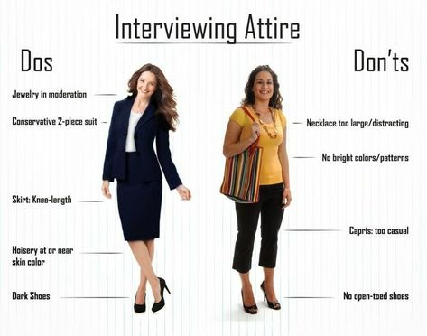

Slide 66

GAME TIME
Interview - Get your game face on!
Will your hard work pay off…if you did not work hard it will show The real competition starts now!
PERSONAL INTERVIEWS
  (Hand out) See list of questions you might have to answer.
Notes:
In today’s economy the competition for jobs is fierce!
tens of thousands of students graduating each year…. Now Hundreds of thousands of people have lost their jobs in the US. Now more than ever, getting an actual interview is so important…and doing well is paramount.
However, not all jobs or companies may be for you. If the interviewer is rude, uninterested, if the building is dirty…this might not be the place you want to be at….but don’t show it then. Wait to see if you get the job and decide then ….You don’t want to hurt your chances before you get an offer.
just as an employer wants a great employer, you want to work for a great company….
Entry level jobs and entry level companies…..this is how you get experience to build the resume….this is how you learn.

Slide 67

GAME TIME!
Time to..GO FOR IT!
You now have the opportunity to shine and sell yourself as the best for the job
This is NOT a time to leave anything on the field…or interview room ☺
Notes:
It will be you and the interviewer….some interviewers will be good others will not. Remember the goal…get the job offer. Don’t be surprised to see more than one interviewer…or having to go through more than one interview.

Slide 68
THE INTERVIEWER
Not always good at interviewing
May not have read you resume or application thoroughly.
Not always the decision maker for hiring
  This may be first of two interviews
Might be more than one person interviewing.
May ask questions to evoke a reaction or to make you feel uncomfortable.

Slide 69

List out Do’s and Don’ts for Interviews

Slide 70
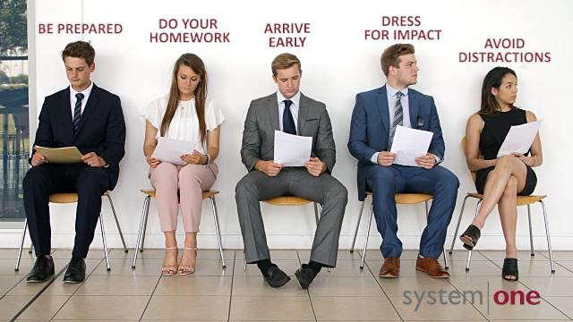

Slide 71
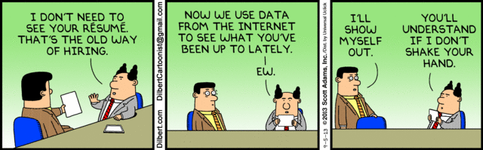

Slide 72
Top things that hurt your chances in an interview
Cell Phone Rings…and then answered
Is disinterested
Inappropriately Dressed
Arrogant
Talking negative about former employer/employees
Chewing gum
Bringing child, friend or spouse

Slide 73
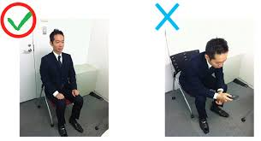

Slide 74
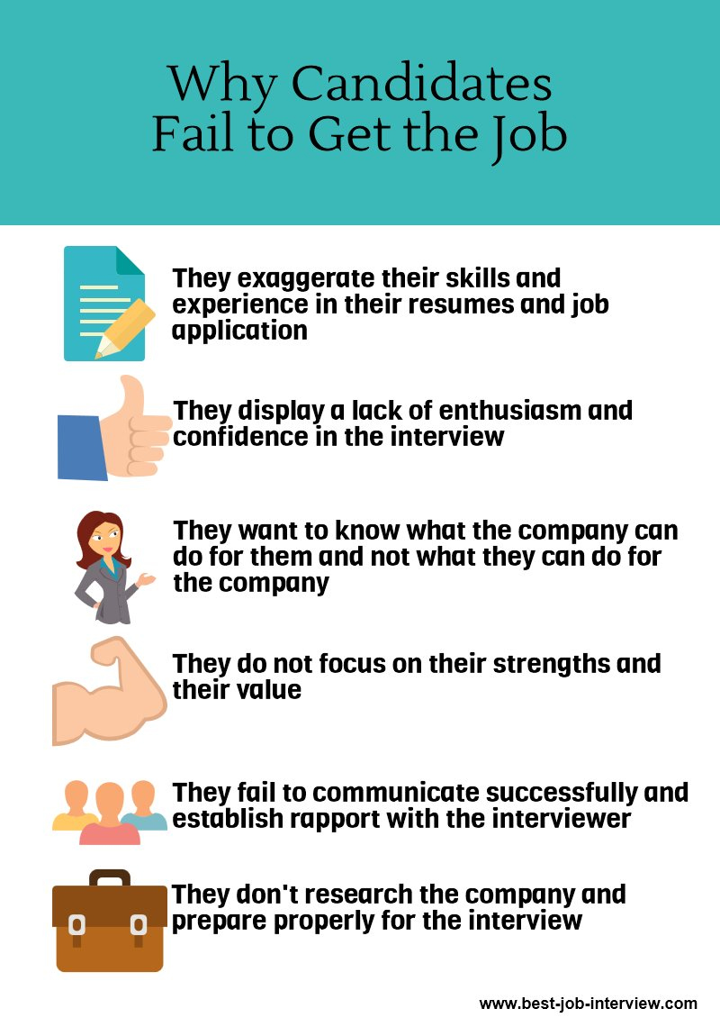

Slide 75
Make an Interview Checklist
Some of the following items might be on this list…
Remember, reading this will not help you get a job…..
You MUST practice to be great at an interview. You must beat out EVERYONE else…(Attitude)
What is 2nd place in a job interview.

Slide 76


Slide 77
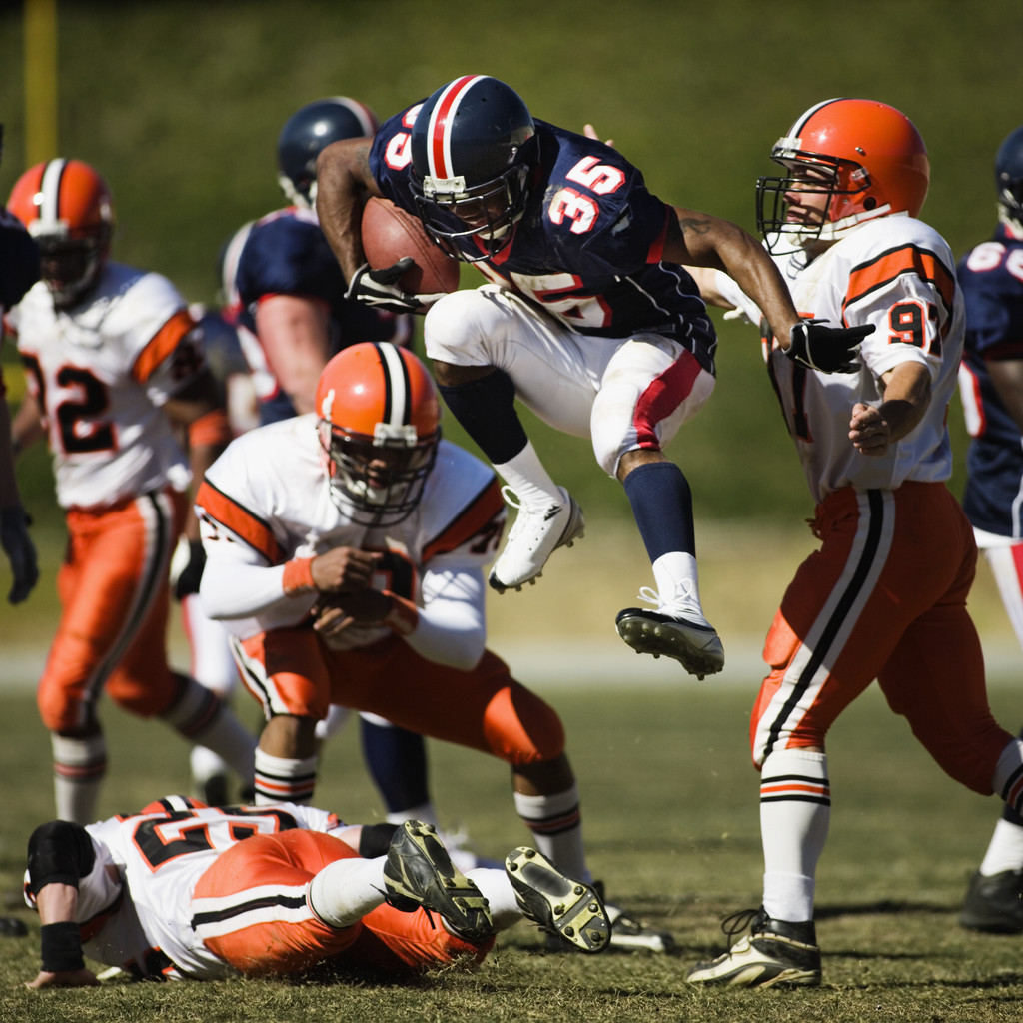
DO THIS
Bring a copy of your resume or application.
Dress professionally
Grooming
Positive Attitude
Body language
Gum, Betel nut, “guests”
Piercings
Leave the Cellular phone home!...at least silent.

Slide 78
DO THIS!
Be on time.
Eye Contact
Firm Handshake
Fidgeting – hands on - face in hair
Posture
UMM – Like – You Know
Speak clearly

Slide 79
DO THIS!
Have 1 or 2 questions prepared
  1 Can you tell me of what training I can expect to go through.
  2 When do you plan on making a decision.
Smile and relax…because you are prepared!

Slide 80
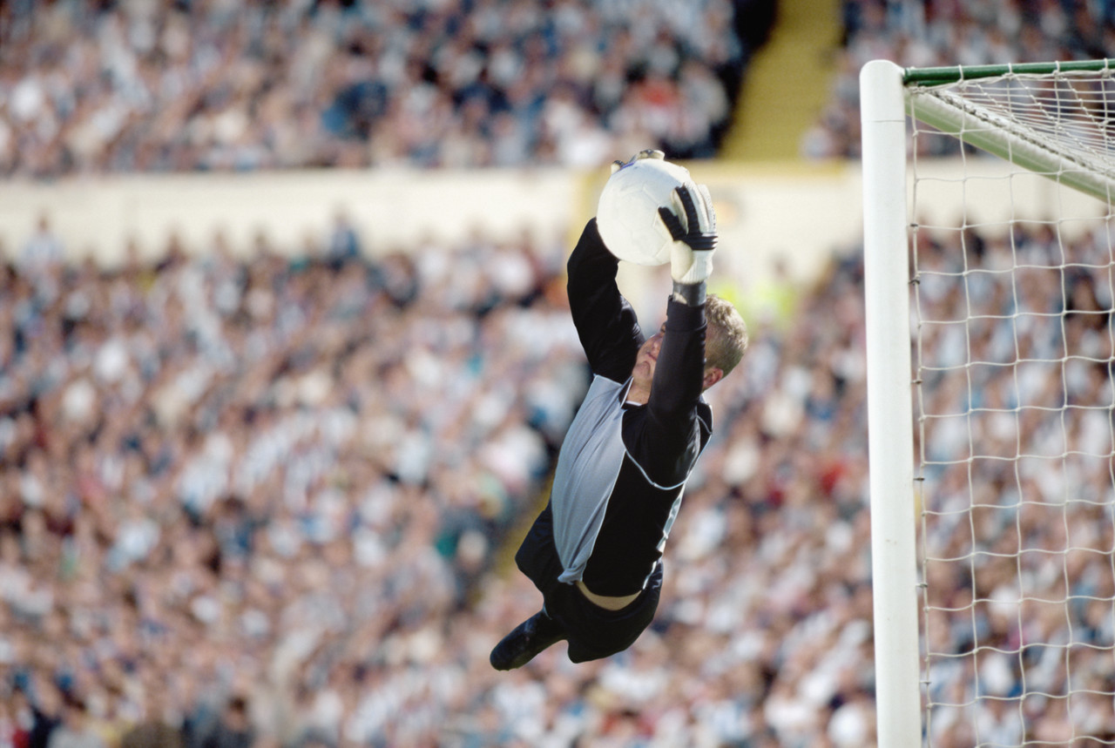

DO THIS!
Use action word
Answer questions
  Truthfully
  Accurately
  Articulately
  Concisely
  Focus on you,
    not others
Notes:
Organized, developed, responsible for, leadership, savings, improved,

Slide 81
DON’T DO THIS!
Say you need a job
Say you need money
Say you’ll “do anything”
Say “when do I start”…
GIGGLE ☺
Notes:
An interview is not a job offer

Slide 82
DON’T DO THIS!
Don’t talk bad about you past employers
Don’t Complain
Don’t tell long stories
Be Desperate
Ask “How Much Will I Get Paid”
Notes:
An interview is not a job offer

Slide 83
DON’T forget to practice. ..
if you cannot express yourself about you and your skills you hurt your chances of getting hired.

Slide 84
Let practice how to practice!
I need 5 volenteers

Slide 85
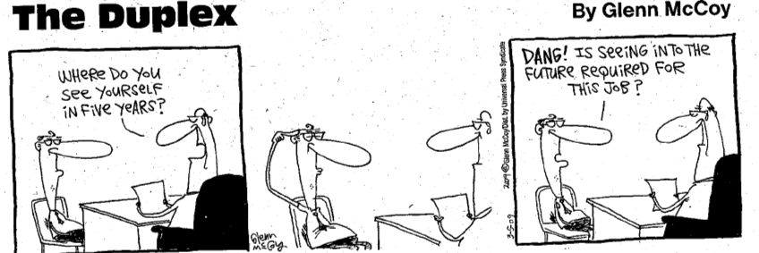
Be prepared for all types of questions

Slide 86
Can you answer these 5 questions
How can you help our company?
Why do you want to work for us?
What is your greatest strength?
Who do you look up to and why?
What are your plans 2 year from now?

Slide 87
How do we answer these questions?
You need to think about your answer
You need to talk about yourself and your skills

Slide 88


Slide 89
Disclosure of your disability
100% your choice. If you are working through OVR, required skills will have been disclosed.
YOU WILL GET QUESTIONS LIKE….
How much can you lift?
Are you able to drive?
Would be ok standing for hours at a time?

Slide 90
Know your what you write
Make sure you know the details of your resume or application and that it reflects the true you.
It is highly recommended that you get people to assist in the development of these tools.

Slide 91
GET A PARTNER!
Job interviewing requires practice
Practice CANNOT be done in the mirror
Work with someone you trust and want to help you
Remember You are not the only one…you have dozens of people looking at the same position.
To get the job you have present the best of you

Slide 92

IMAGE & SKILL SET
A resume is basically a listing of your accomplishments
Now you need to answer to what you have put on your application or resume!
Notes:
A resume and cover letter just gets you into the door…like getting to “try out” for the team…
Concise,
Creativity, Paper color
Font,
Accounting firms and Advertising companies will have different ways are looking at your resumes.

Slide 93
Strengths and Weakness/Likes & Dislikes
What are my Strengths?
        What are my Weaknesses?

Slide 94
Strengths and Weakness
Handsome , good looking, smart, in shape, good kisser, kind to animals….may be true…but not what the employer is looking for.
Saying you have no weaknesses is a sure sign that you don’t know yourself well enough…

Slide 95
Strengths and Weakness
Technical Skills: Knowledge based.
  Certifications, CPR, First Aid, Training from school program or former employer.
Soft Skills: learned from past experience.
  Time Management, working with others, taking criticism, failure, success, handling stress
Notes:
A good way to seek your S&W are looking at what skills you have.

Slide 96
Strengths and Weakness
Personal Skills: Talents and traits
  Friendliness, Shyness, willingness to learn, assertive, sports or extracurricular activities
Use the job advertisement skill listing to help prepare, what skills do you have experience with.
Notes:
A good way to seek your S&W are looking at what skills you have.

Slide 97
Strengths
"I am very headstrong. I really like to be challenged in my job, and I just want to learn as much as I can in my position. At the end of the day I need to be able to look back on my day and feel good about the job that I've done. I guess you could call it sense of self worth. That's why I always put my all into everything I do."

Slide 98
Strengths
Positive Attitude
Determined
Able to Prioritize
Believe in myself
If you don’t know….ask your friends and family
Make sure you are honest and don’t give a canned answer.

Slide 99
Weakness can be sold as Strengths
This is where preparation pays off.
Weakness should come out as a problem which is (almost) solved and not a critical (hopeless) trait that cannot be helped.
Let’s us list 2 strengths and 2 weakness 5 minutes
Compare and share. Are there any similar ones?

Slide 100
Weaknesses
Everyone says these….and we (interviewers) know it is canned
  I procrastinate
  I am a workaholic…
Possibly Better….but they have to accurate and uniquely yours…
  Overly Friendly ;
  Focus on work when not at work
  Hard time saying no
  AGAIN ask your friends and family

Slide 101
Be careful
"So tell me, Mrs. Jones," asked the interviewer, "do you have any other skills you think might be worth mentioning?" "Well, actually, yes," said the applicant modestly. "Last year I had two short stories published in national magazines, and
I also finished my novel."
"Very impressive," commented the interviewer, "but I was thinking of skills you could apply during office hours."
Mrs. Jones explained brightly, "Oh, that was during office hours."

Slide 102
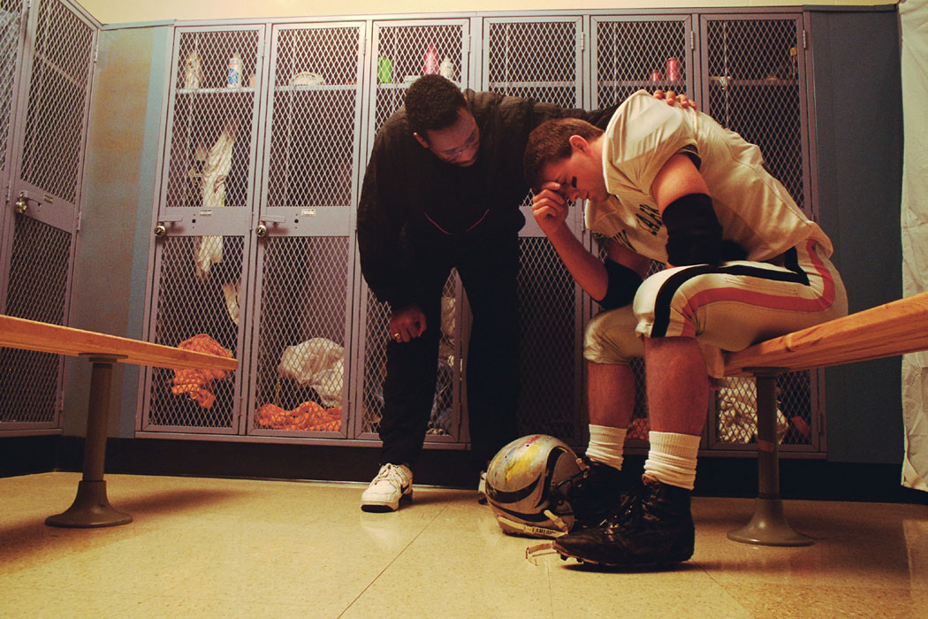
POST GAME - After the Interview
No matter how the interview went…you need to send a thank you letter
Identify and evaluate
Reflect & keep positive and keep training
There will be many interviews in your future.
Notes:
There will be other interviews….although no two are alike. You can learn from each if you take the time to evaluate

Slide 103
THANK YOU NOTE
Thank the employer for the interview
A line to remind them of your skills
  Maybe something not mentioned at the interview
Provide your contact information
Chek you’re speling and Grandma.
Sign the note with first and last name
Drop off within 24 hours (here on Saipan)

Slide 104

SCORE! You get a job offer!
If you do not get the job, send a thank you letter…it could open other doors.
Notes:
Mission accomplished

Slide 105
Got the job offer!....Let’s talk!
Benefits
Wages
Hours

Slide 106
Let us talk REALITY!

Slide 107
When you get a job….KEEP IT!
A poor work history is hard to escape
7.25 for 4 months
7.25 for 2 months
7.25
5for 4 months
7.25 for 3 months

Slide 108
Key things to remember once you get a job
It is easier to get a job, when you have a job.
Is 0.00 greater or less than 7.25?

Slide 109
Try to always move up
Experience, better company and or Money
Entry level
More $ or Experience
More $ or Experience

Slide 110
The Cost of Having a Job
Kagman to Koblerville, San Roque or Garpan…is about 5-6 miles.
Round Trip is 12 mile..
Cars get between 19 and 30 miles per gallon.
Gas = 5.6/gallon
It is costing you $5.00 to get to work each day
USE CODA

Slide 111
TOO FAR!
At 7.25 = $1160 per month at 40 hours…
    $870 at 30 hours
    $580 @ 20 hours
The cost for gas = $30.00 for the week or $120 a month.
There is ALWAYS a cost to getting to work…so make sure you do the math.

Slide 112
DON’T QUIT
Job searching is tough and can be discouraging…but once you land the job there is a worthwhile reward
Quitting without notice is true warning sign for employers

Slide 113
Quitting is easy!
Pain is temporary. Quitting lasts forever
“If you quit ONCE it becomes a habit.Never quit!!!”
“It's always to soon to quit!”
“I shed a tear when I meet somebody who always quits. Reliable people are so rare in this world.”

Slide 114
Disabilities at work
Focus on abilities not disabilities
When to disclose?
Accommodations
Discrimination
EEOC
NMPASI
OVR

Slide 115
Resources
YOUTUBE
GOOGLE
NMPASI
OVR
CNMI Department of Labor

Slide 116
LET’S
TAKE
THE SHOT
NOW!

Slide 117
Good Luck Any Questions?

Slide 118
Notes:
Lunch
Keynote Address

