Slide 1
Autism in the Workplace
tacqe.com

Slide 2
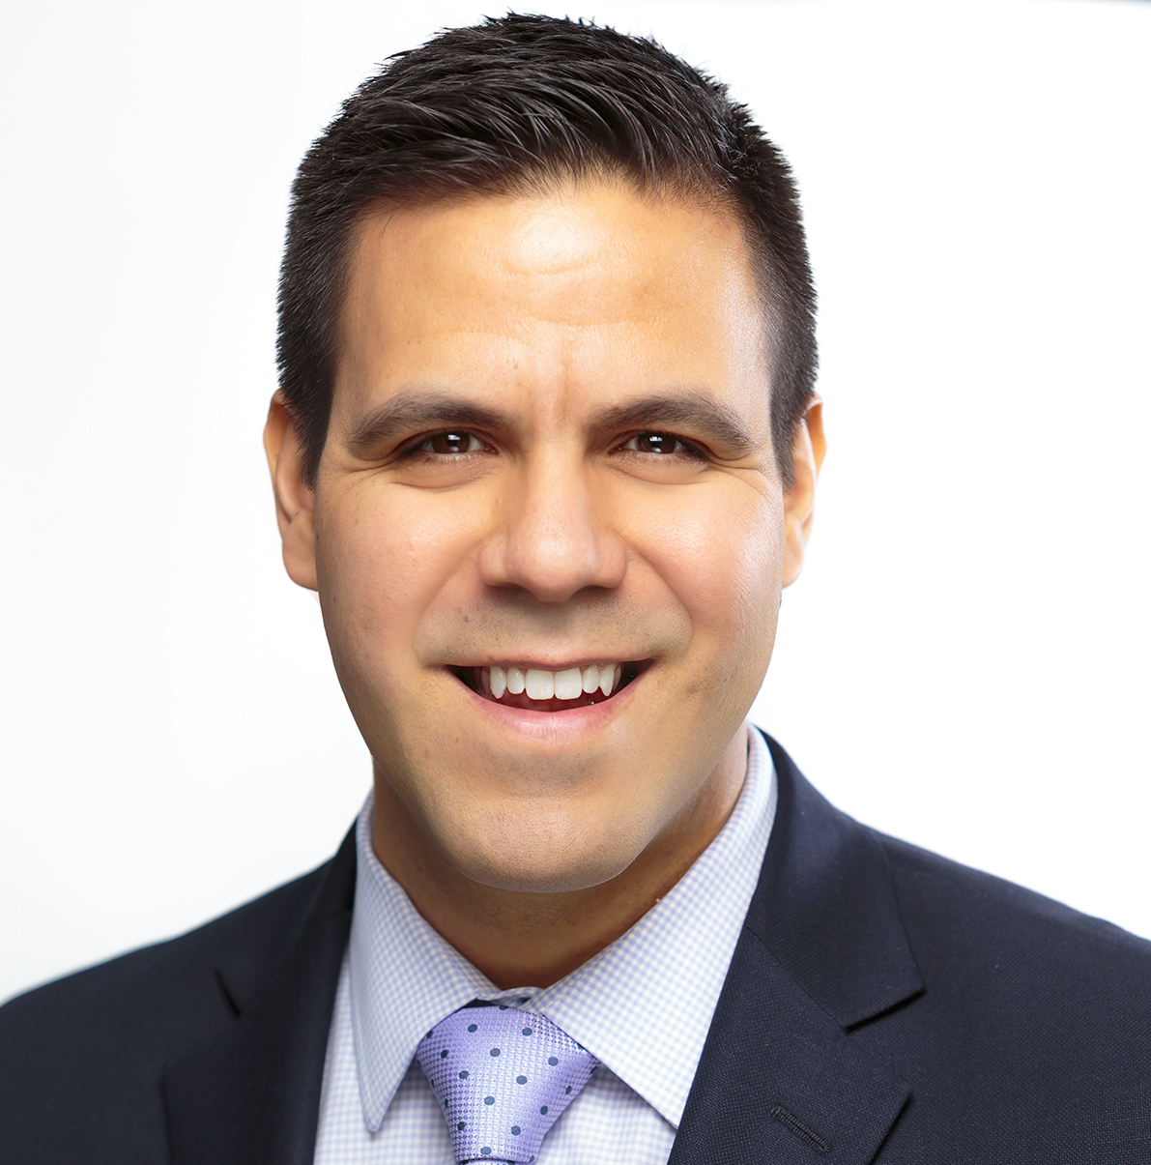
Presented by
David’s Background
Autism/Neurodiversity Employment Researcher
Former Job Coach
Former Paraeducator & Fitness Coordinator at a School for Children with Autism
15+ years experience as an Entrepreneur
David S. Geslak
President & Founder
Notes:
NEED EPS Logo of AW (Keith)

Slide 3

Presented by
Deborah Lee
Researcher- VRTAC-QE
University of Wisconsin-Madison
Emily Brinck
Researcher- VRTAC-QE
University of Wisconsin-Madison
tacqe.com
Notes:
Tim or Stacie?

Slide 4
Vocational Rehabilitation Technical Assistance Center for Quality Employment
Goal: The Technical Assistance Center for Quality Employment will increase the number and quality of employment outcomes for individuals with disabilities through training and technical assistance to State VR agency personnel.
The VRTAC-QE will support State VR agency personnel to implement innovative and effective employment strategies and supporting practices.
tacqe.com

Slide 5












Partners

Slide 6
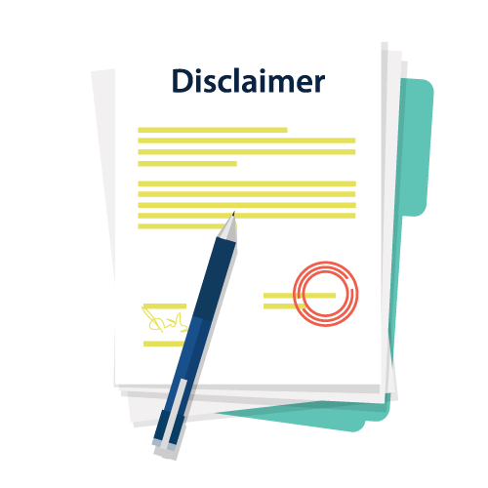
Acknowledgement & Disclaimer:
The contents of this presentation were developed with support from the Vocational Rehabilitation Technical Assistance Center for Quality Employment funded by the U.S. Department of Education, Rehabilitation Services Administration (CFDA H264-K200003).
The ideas, opinions, and conclusions expressed are those of the presenters and do not represent recommendations, endorsements, or policies of the U.S. Department of Education.

Slide 7


Learning Objectives
Participants gain a basic understanding of the characteristics of autism and what it can look like in the workplace
Participants will develop greater understanding of the accommodations of individuals with autism when entering the workforce
Participants will develop greater understanding to support individuals with autism from job application to employment.

Slide 8
What is Autism Spectrum Disorder (ASD)?
Persistent deficits in social communication and social interaction across multiple contexts.
Restricted, repetitive patterns of behavior, interests, or activities.
Symptoms must be present in the early developmental period.
Symptoms cause clinically significant impairment in social, occupational, or other important areas of current functioning.
These disturbances are not better explained by intellectual disability or global developmental delay.
Diagnostic and Statistical Manual of Mental Disorders, Fifth Edition (DSM-5)

Slide 9


What is Autism Spectrum Disorder (ASD)?
1 in 44 children in the United States are diagnosed
World’s fastest growing developmental disorder
4x more likely to be diagnosed in boys than girls
Over 2% of US population (2 million+)
Live a normal lifespan
No known cause of autism

Slide 10
What Autism Can Actually Look Like
“If you’ve met one person with autism, you’ve met one person with autism.”
- Dr. Stephen Shore

Slide 11
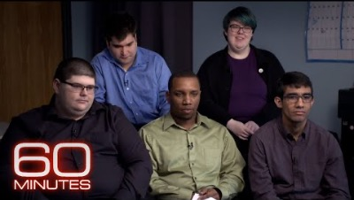

Slide 12



The Misunderstanding of those with ASD in the Workplace
Only those perceived as high end of the spectrum can work
College degree
Tech, finance, and coding
Unemployment rate among those with autism is 85%

Slide 13

Notes:
Prater

Slide 14
Levels of Support for those with ASD
Severity Level | Social Communication | Restricted, repetitive behaviors
Level 3 “Requiring very substantial support” | Severe deficits in verbal and nonverbal social communication skills cause severe impairments in functioning, very limited initiation of social interactions, and minimal response to social overtures from others. | Inflexibility of behavior, extreme difficulty coping with change, or other restricted/repetitive Behaviors markedly interfere with functioning in all spheres Great distress/difficulty changing focus or action
Level 2 “Requiring substantial support” | Marked deficits in verbal and nonverbal social communication skills; social impairments apparent even with supports in place; limited initiation of social interactions; and reduced or abnormal responses to social overtures from others. | Inflexibility of behavior, difficulty coping with change, or other restricted/repetitive behaviors Behaviors are obvious to the casual observer and interfere with functioning in a variety of contexts. Distress and/or difficulty changing focus or action
Level 1 “Requiring support” | Without supports in place, deficits in social communication cause noticeable impairments. Difficulty initiating social interactions, and clear examples of atypical or unsuccessful response to social overtures of others. May appear to have decreased interest in social interactions. | Inflexibility of behavior causes significant interference with functioning in one or more contexts Difficulty switching between activities. Problems of organization and planning hamper independence
Diagnostic and Statistical Manual of Mental Disorders, Fifth Edition (DSM-5)

Slide 15
Paper Folding Activity (10 minutes)
Fold the paper in half.
Fold the paper in half again.
Tear off the bottom right corner.
Turn the paper upside down.
Tear off the other bottom right corner.

Slide 16




Autism Characteristics &
Common Challenges Seen in the Workplace
Communication
Social Skills
Sensory Processing
Repetitive Behaviors

Slide 17
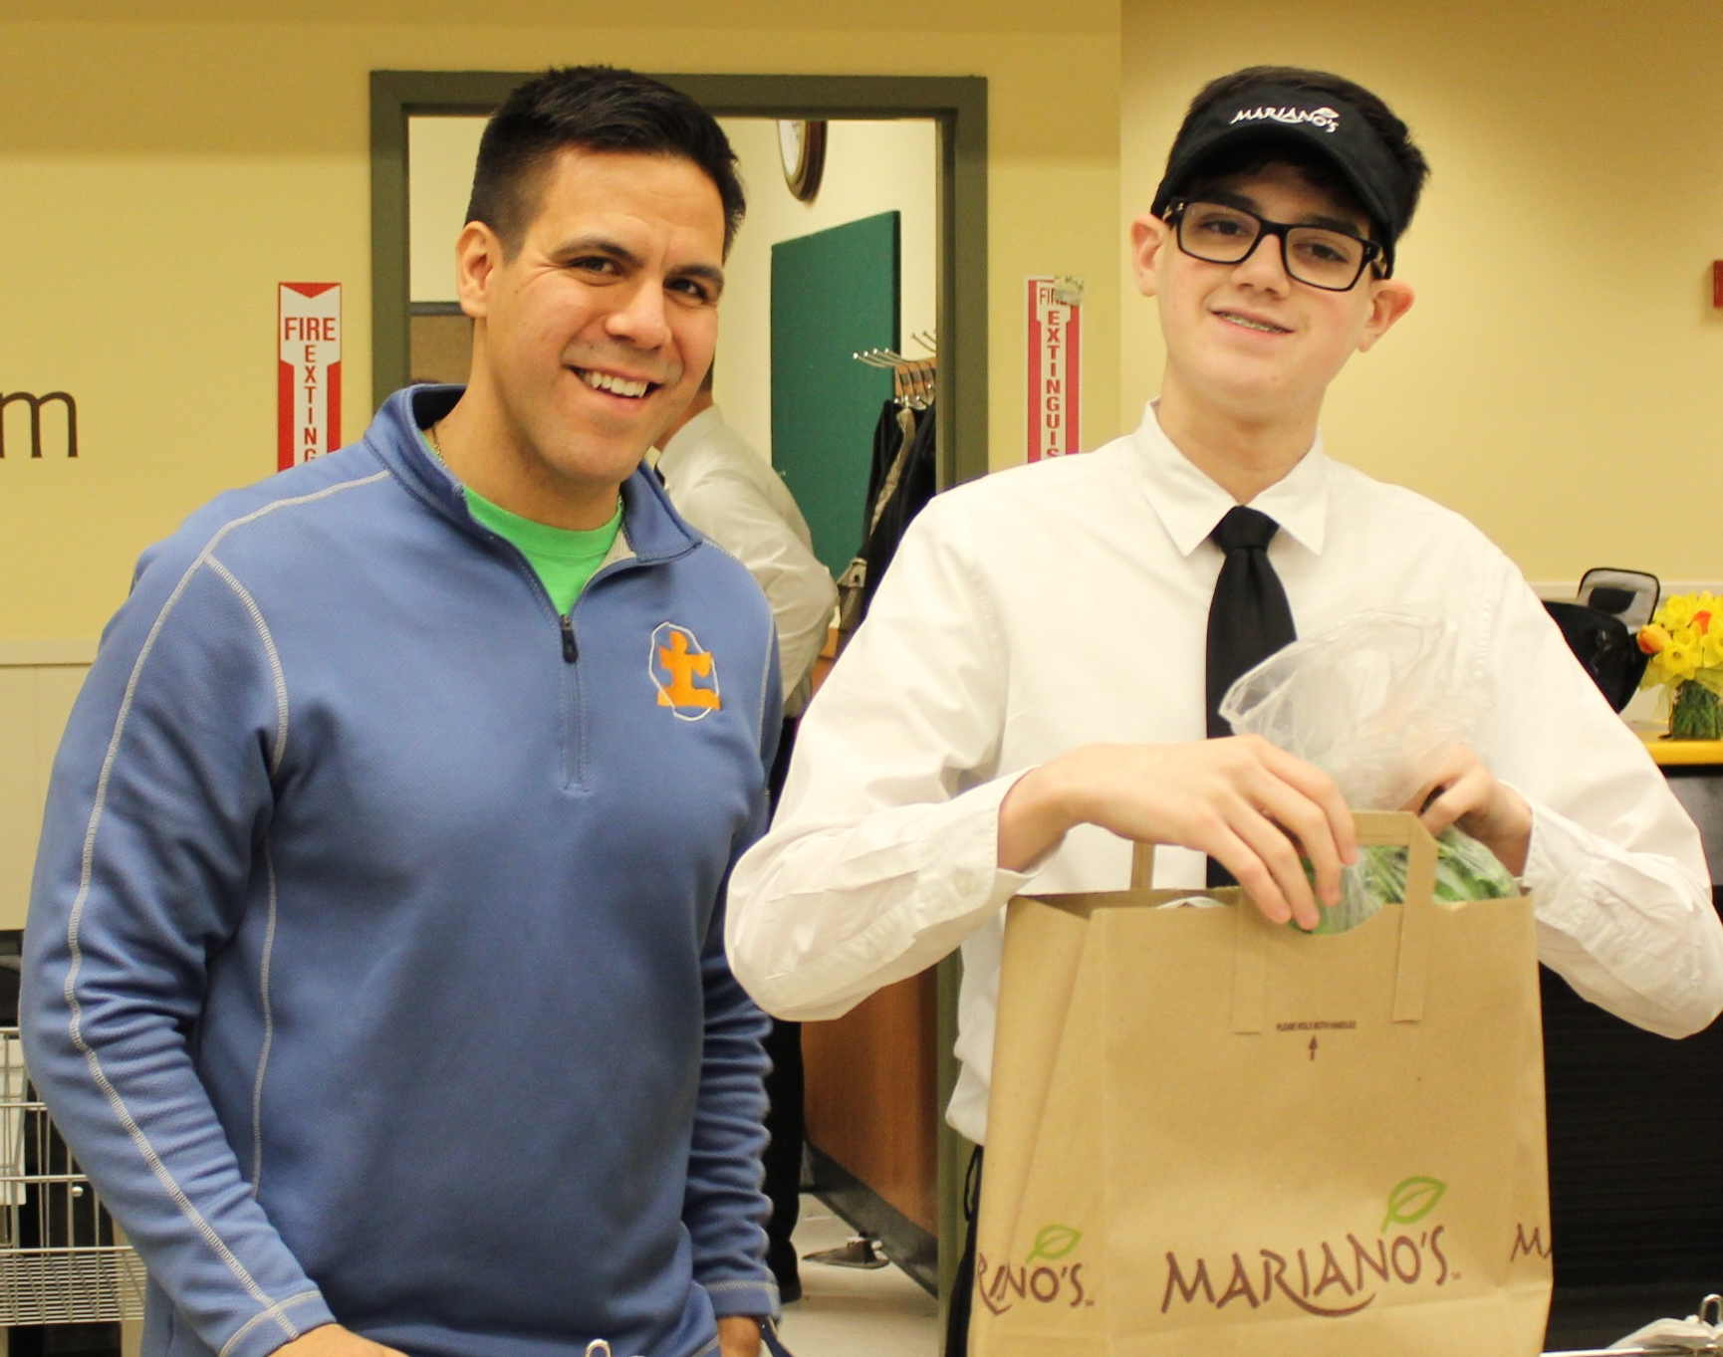
Say What You Mean, Mean What You Say
Communication
Challenges with:
Initiating Conversation
Following Multi-Step Directions
Understanding Time
Sarcasm

Slide 18
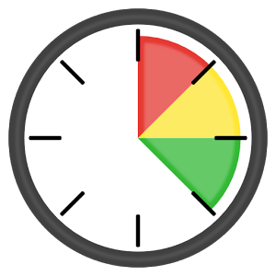
Asking a Question or Giving a Job Request
Communication
Allow time for many to process information

Slide 19


It’s Not a Problem, It’s an Adjustment
Social Skills
Challenges with
Eye contact, or proper greetings
Understanding jokes
Working in groups
Recognizing bullying

Slide 20




Be Sensitive to the Environment
Sensory Processing
May not want to be touched (high five, pat on the back) or touching could be over indulged
Not just loud noises, but even a dripping faucet can be a distraction
Bright florescent lights, blinking LED lights and spinning objects can be distracting
Smells can be a distraction

Slide 21
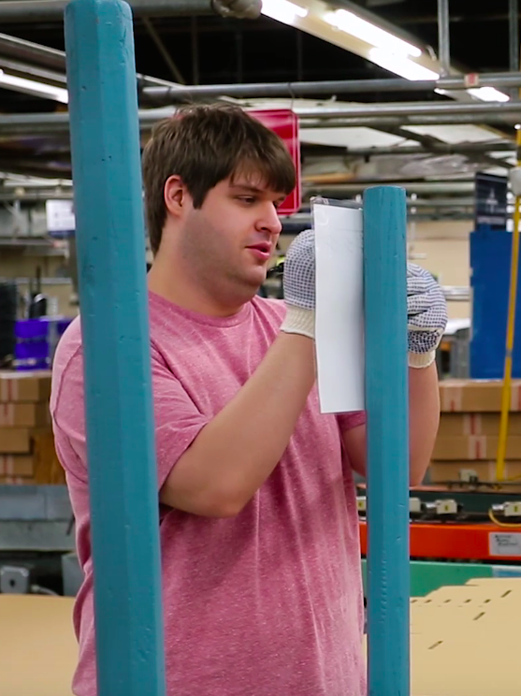
“Out-of-the-Ordinary” Movements
Repetitive Behaviors
Repetitive movement of body or objects
  Rocking, hand flapping, spinning
“Scripting” – repeating phases, words, or sounds
OCD in activities and interests
Random disruptions

Slide 22

Notes:
This Gilster Mary Lee video- - perspectives from their CEO and HR Manager

Slide 23




Creating Success for those with ASD - and the Company - in the Workplace
  Staff Training & Enlightenment
  Evidence-based teaching practices (Universal design)
  Structure & Predictability
  Exercise*

Slide 24
Strategies for Onboarding Process
How do we train the individual to do the job?
Why are people not successful at these jobs?
Are we having conversations around good job fits for that individual?

Slide 25
Strategies for Onboarding Process
Find Jobs that are Structured and Repetitive
2) Training ALL Staff and Co-workers that have or may have contact with the new employees
3) Support the Individuals during the Onboarding Process

Slide 26

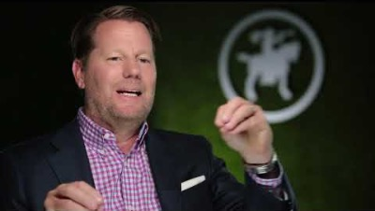
Notes:
CEO shares why he made the commitment to hire AND that hiring is NOT for Charity.

Slide 27
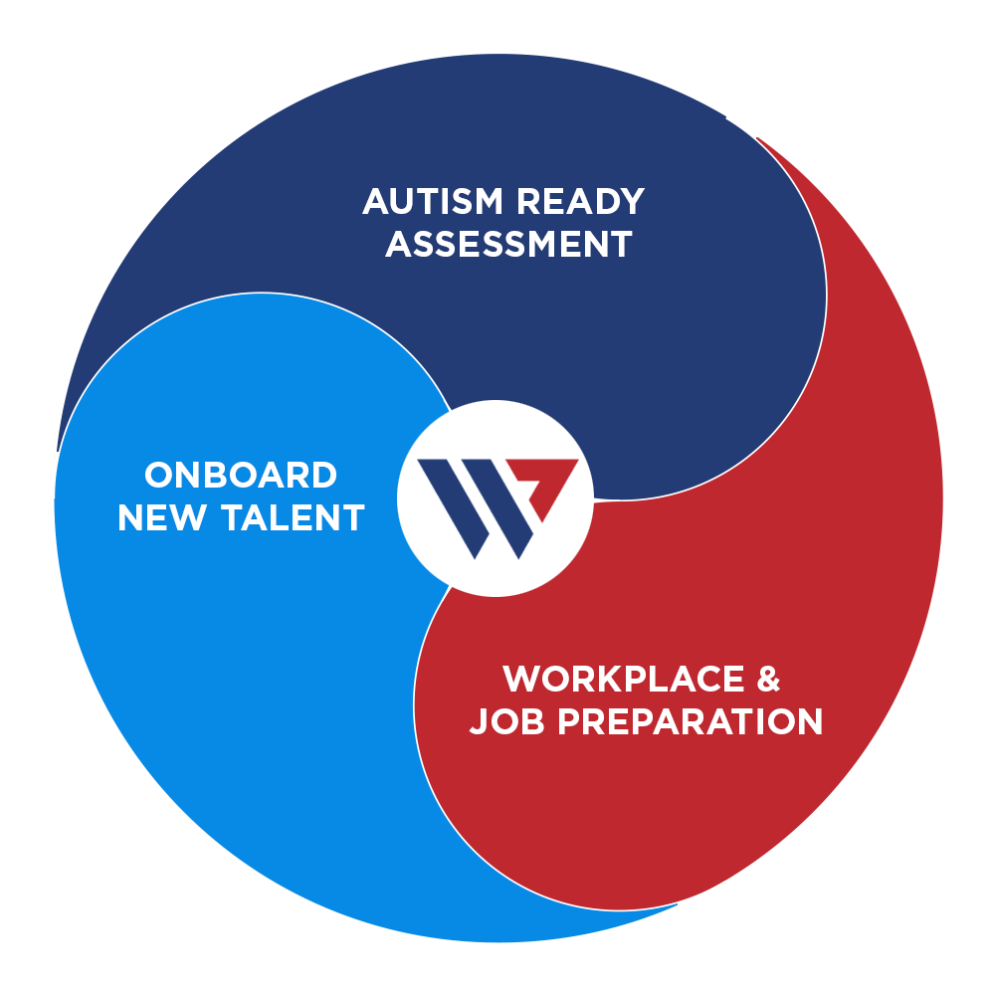
A New Approach for Autism Employment
Autism Ready® Assessment
  Review areas of challenge with leadership team
  Identify appropriate jobs with department heads
  Identify current retention rates & cost of turnover
Workplace & Job Preparation
  Create universal standard work & skill assessment
  Identify productivity metrics
  Staff training for current employees
Onboard New Talent
  Support current hiring process
  Monitor new hire productivity & integration
  On-site/virtual support as jobs progress

Slide 28
Small Family Businesses
Workforce is loyal and dependable
2) Internship opportunities
3) Can help maintain or improve productivity

Slide 29

Thank you!
Presenters
VRTAC-QE
www.tacqe.com
contact@tacqe.com
tacqe.com
Notes:
Stacie

