Slide 1


Communication Tools for Employers
Presented by:
CNMI Council on Developmental Disabilities
&
Assistive Technology Program

Slide 2

How Critical Is Communication?
Let’s start of with an activity and find out!

Slide 3
Activity Rules
Once the trainer has set up the groups remember to follow these rules:
No turning around
Neither person is allowed to show your drawing
The person drawing can only use three words to communicate, yes, no and repeat
You have 5 minutes

Slide 4
Activity Discussion
Was it a difficult activity?
What were the challenges?
How could we have done it better?

Slide 5
Please refer to your “Communication Tips for Employers” Handout.
Before we take a look at the types of Assistive Technology communication tools let’s look at some basic tips on how to communicate with a person with specific disabilities.

Slide 6
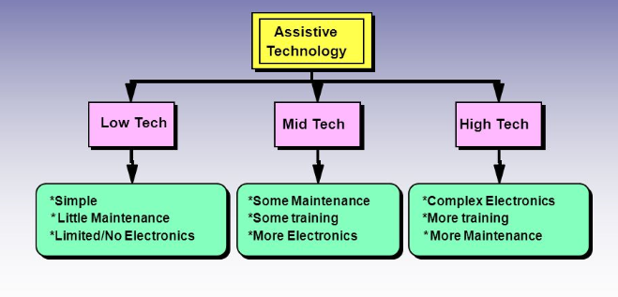
Communication
&
Assistive Technology
“Assistive technology (AT) device means any item, piece of equipment or product system, whether acquired commercially off the shelf, modified or customized, that is used to increase, maintain or improve the functional capabilities of a child with a disability. The term does not include a medical device that is surgically implanted, or the replacement of such device.”
The Individuals with Disabilities Education Act of 2004 [Authority: 20 U.S.C. 1401(1)]
AT falls into essentially three categories:

Slide 7
Areas that AT looks at…..
Seating, Positioning and Mobility
Communication
Computer Access
Motor Aspects of Writing
Composition of Written Materials
Reading
Math
Organization
Recreation Leisure
Vision
Hearing
General and Daily Living Skills

Slide 8
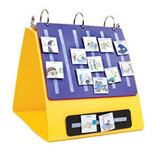
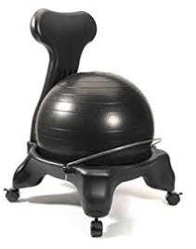
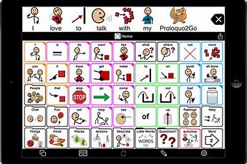


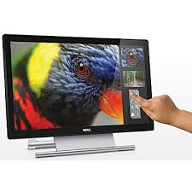

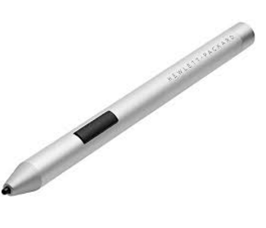
Please refer to your “Communication Access Options” Handout.

Slide 9
Please refer to our brochures for our contact
and additional information.
Thank You
CNMI Council on Developmental Disabilities
And
Assistive Technology Program

