Slide 1

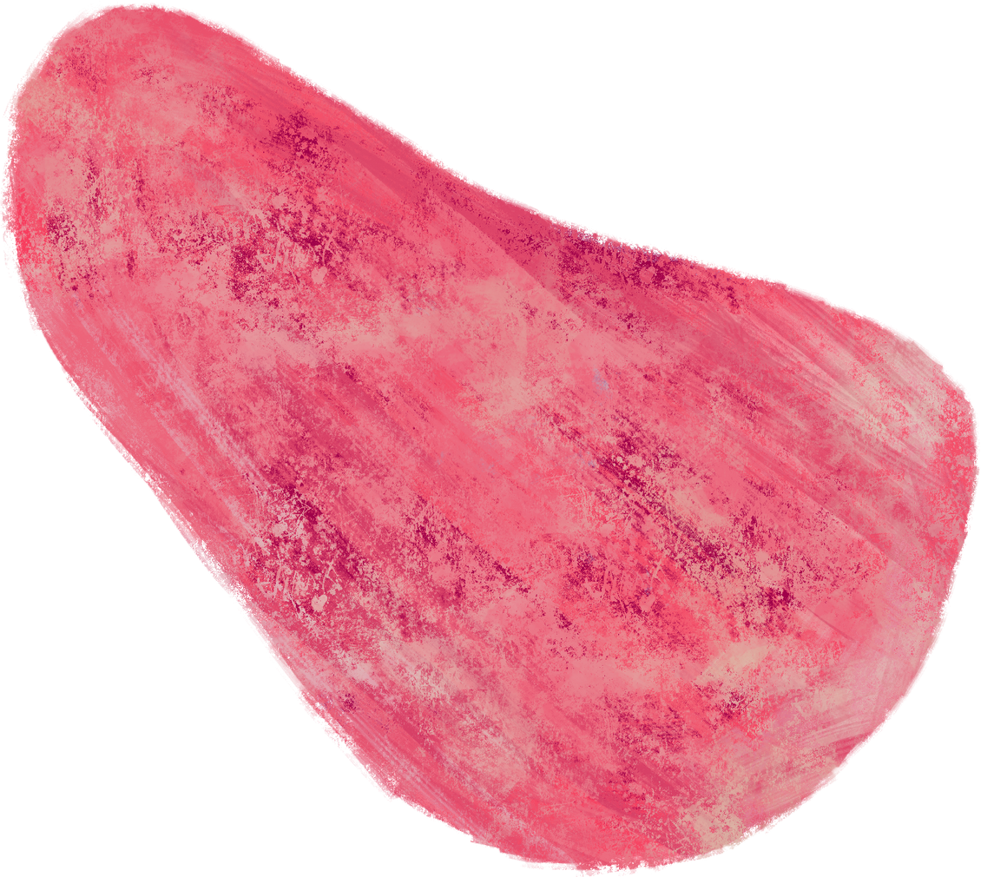









Office of Vocational Rehabilitation (OVR) Presents:
Pre-Employment Transition Services Program (Pre-ETS)
&
Basic Support/Supported Employment Program (BS/SE)

Slide 2



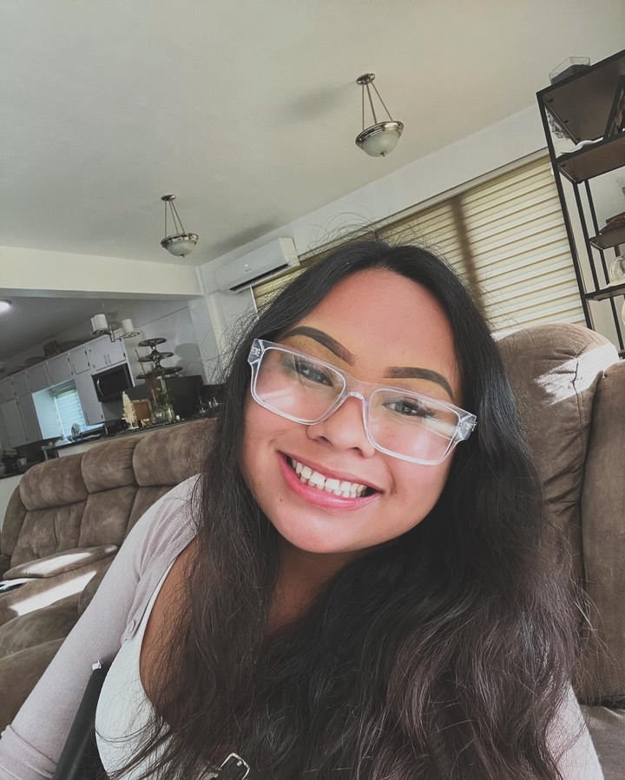



Hello Students!
My name is Jasmine Calvo, VR Transition Specialist

Slide 3




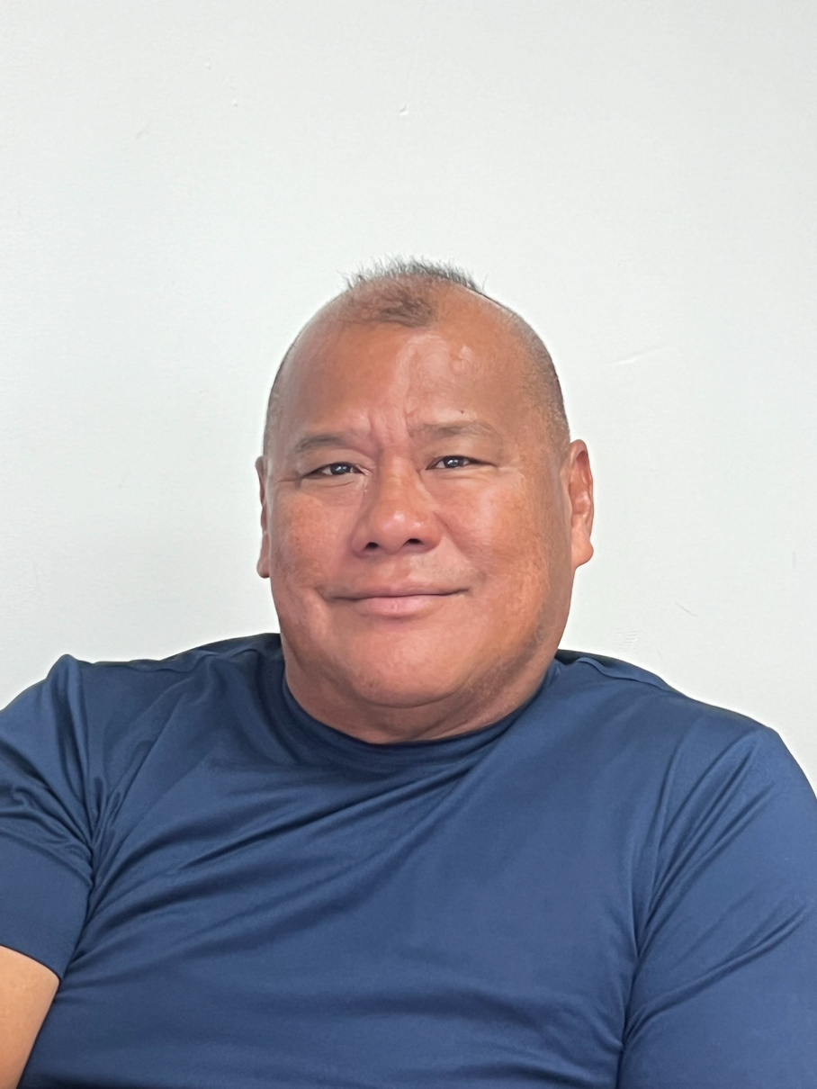
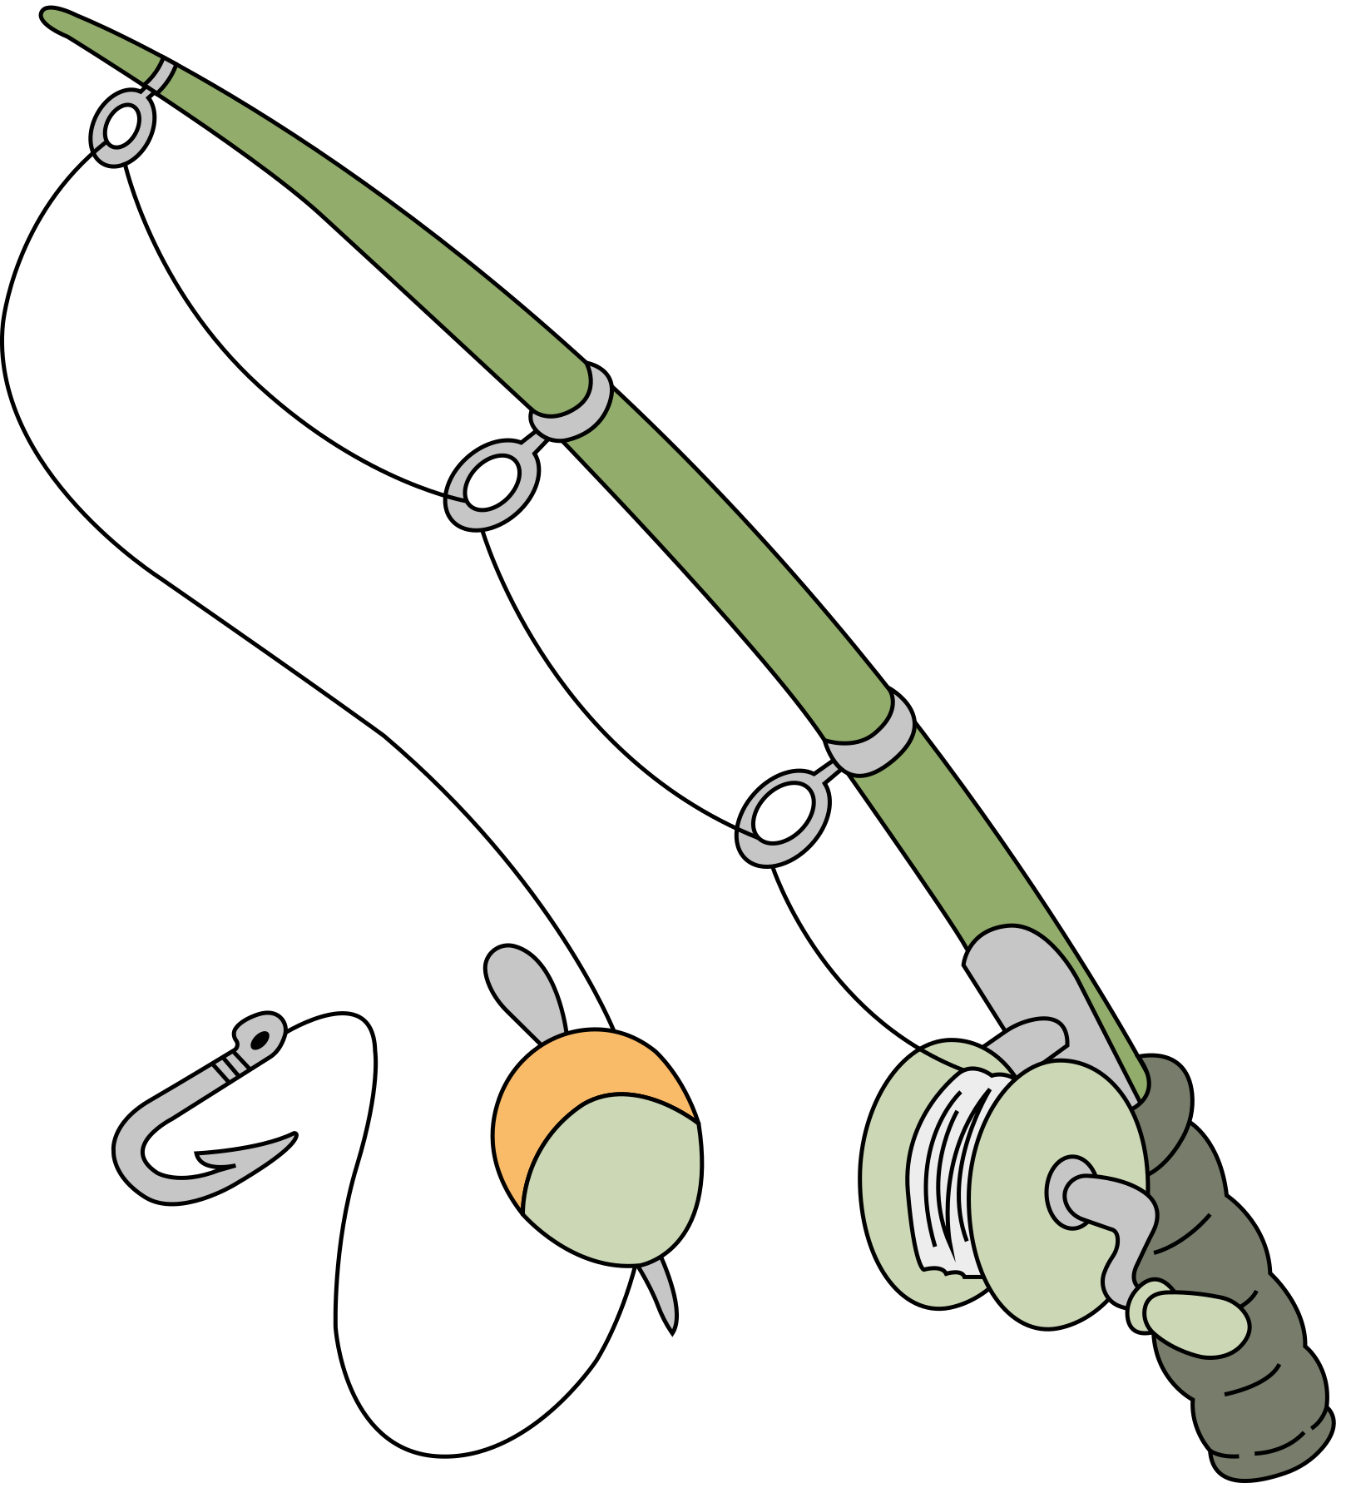
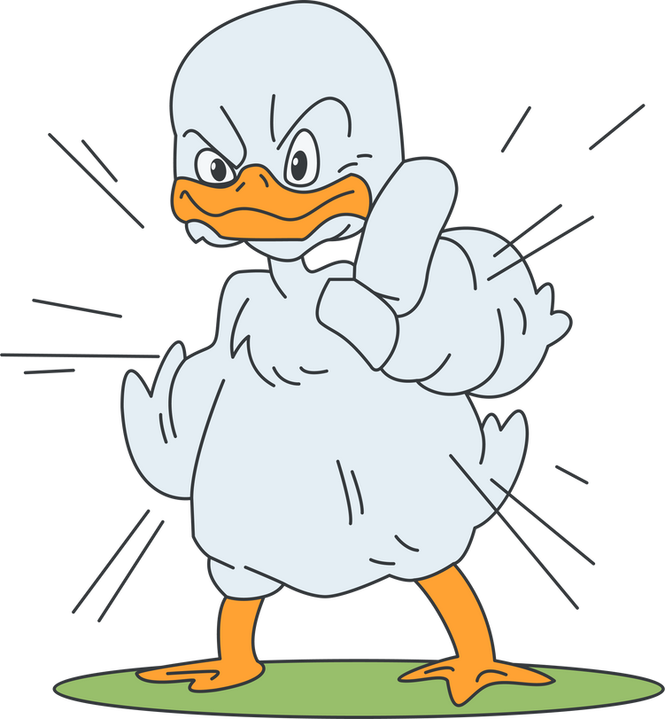

Hi Students! My name is Ray Diaz, VR Counselor!

Slide 4


Let’s talk about Pre-ETS!
What is Pre-ETS?

Slide 5

Five Required Activities
Job Exploration Counseling
Work Based Learning
Post-Secondary Counseling
Workplace Readiness Training
Instruction in Self-Advocacy

Slide 6

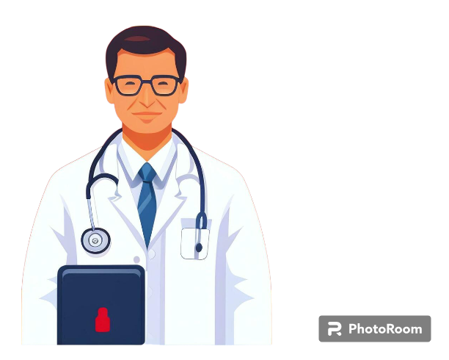



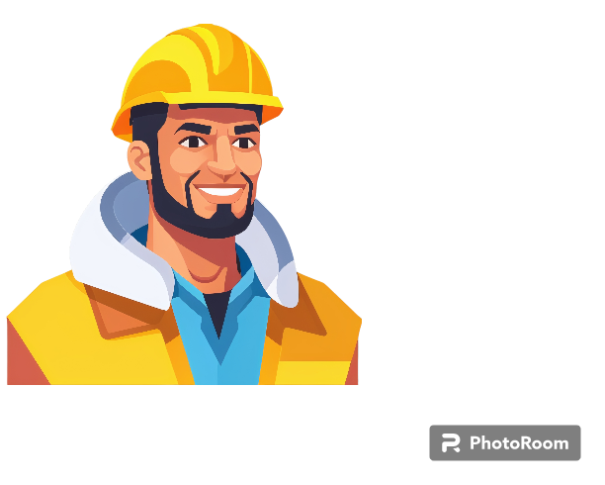
Job Exploration Counseling
What is my dream career...
How do I get there...
I love to cook!
I love to build!
I love my guest!
I love to teach!
I love my patients!

Slide 7


Work Based Learning
How can I gain work experience...
What are some skills I want to practice...

Slide 8


Post-Secondary Counseling
Do I want to go to college, trade school, or military...
What degree/certification do I need to become a...
NMC is fun!
Glad I met that recruiter!
Hands on over at NMTech!

Slide 9



Workplace Readiness Training
How do I make a resume and job application...
How do I manage my money and bills...

Slide 10



Instruction on Self-Advocacy
What are my strengths and weaknesses...
How do I advocate for myself...
DISABILITY
RIGHTS

Slide 11
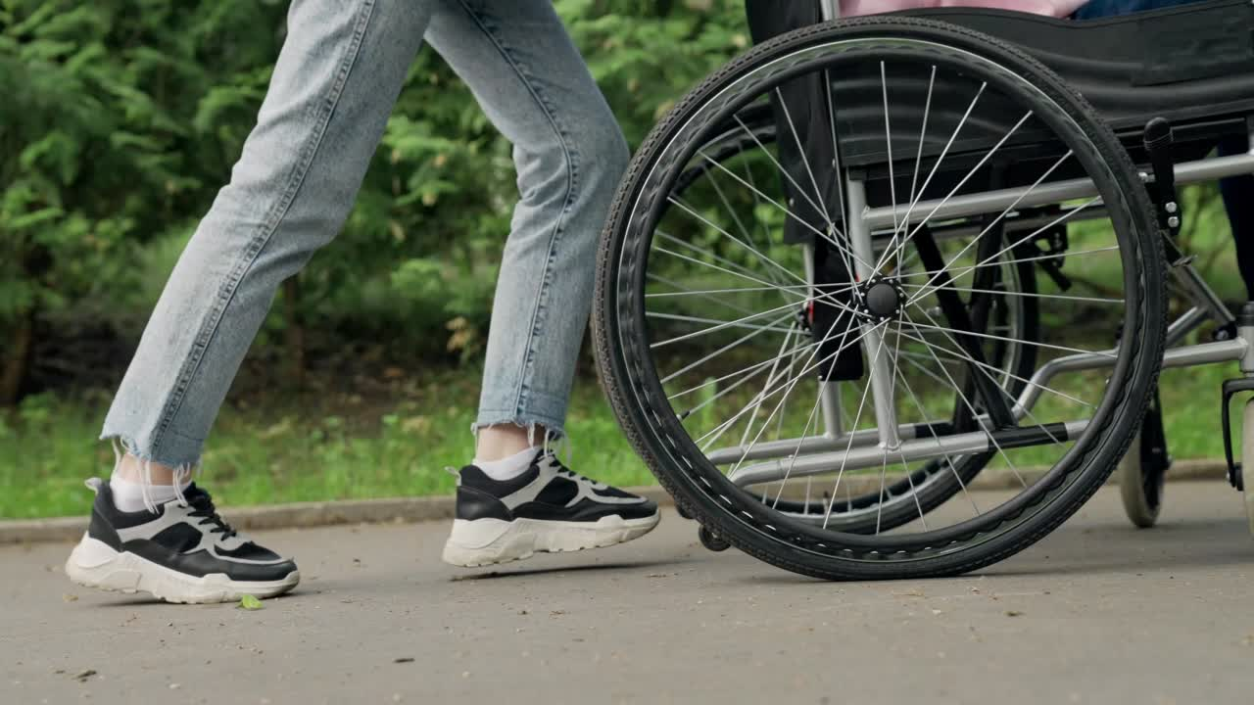
PRE-ETS
IS HERE!
Let’s plan for success!

Slide 12
Basic Support/Supported Employment Program (BS/SE)

Slide 13
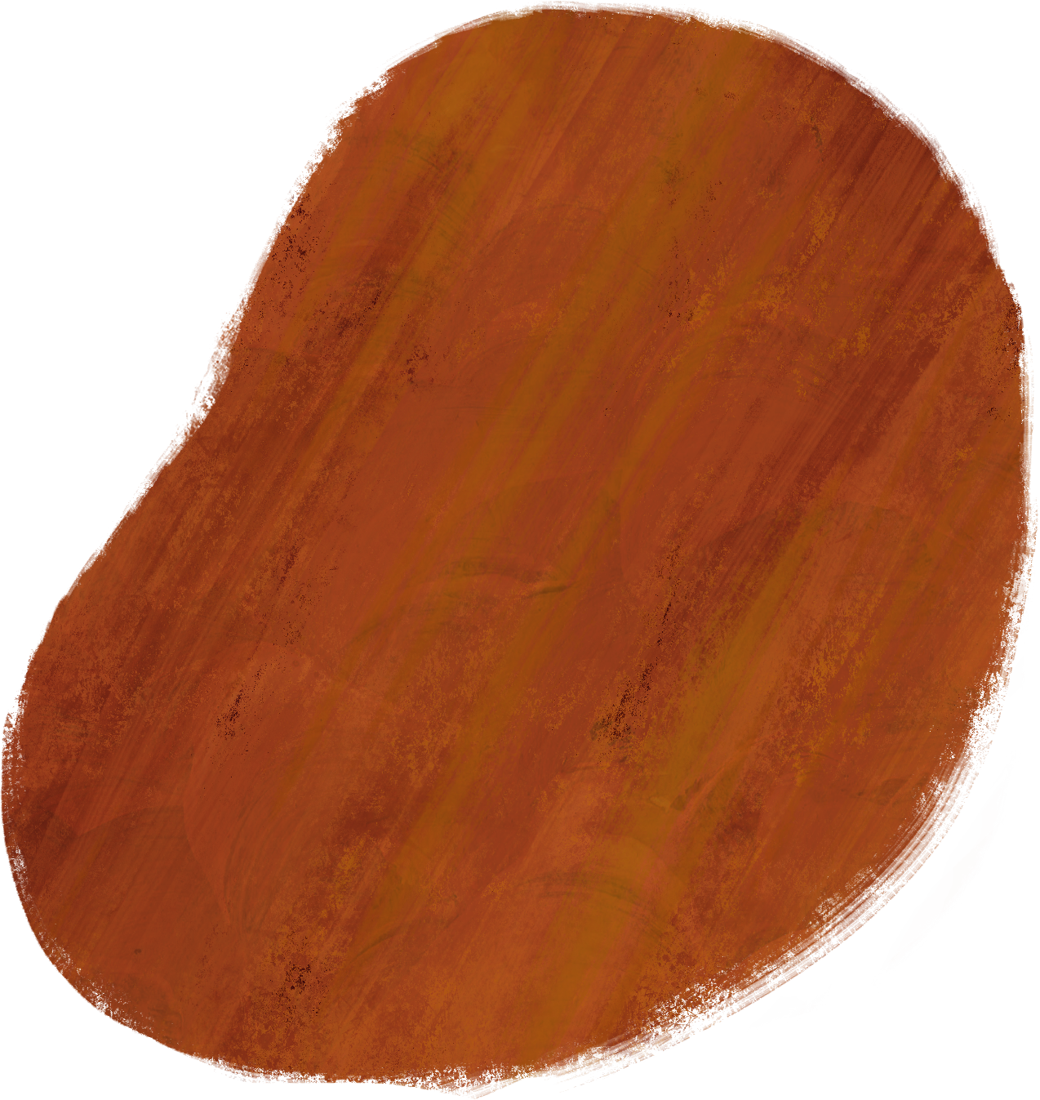



Eligibility Criteria
Physical, Psychological, or Mental Disability
Substantial Impediment to Employment
Require VR Services
*US Citizen or Qualified Aliens

Slide 14
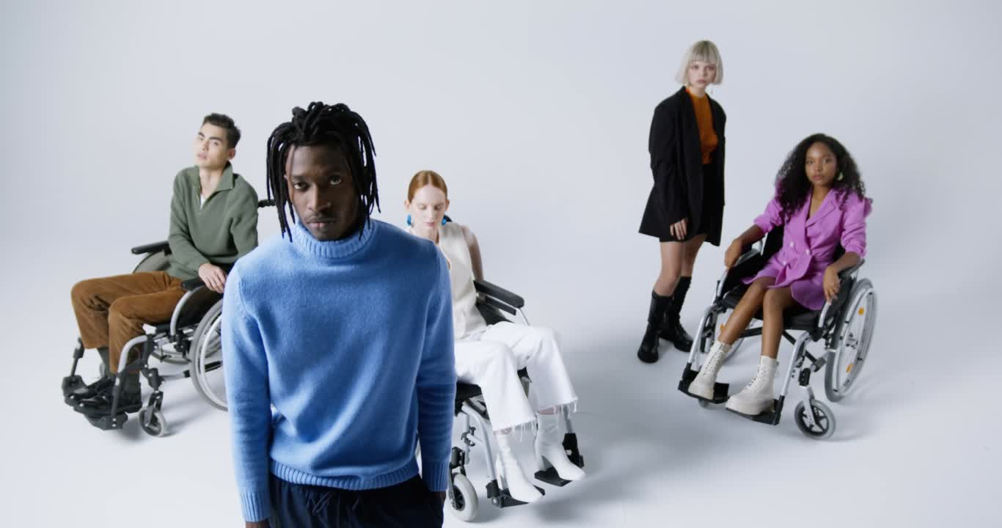
OVR Assists with a Broad Range of Disabilities including, but not limited to:
  Hearing Impairments
  Mobility Impairments
  Post-Traumatic Stress Disorder
  Specific Learning Disorder
  Diabetes

Slide 15
BS/SE Services
  Job Search/Placement
  Job Retention Services
  Counseling and Guidance
  Vocational Trainings
    (NMC, NMTech, GMTC, etc..)
  Assistive Technology
  Personal Attendant
and More!

Slide 16

SUCCESS
IS POSSIBLE
Let’s plan for success!

